Slide 1
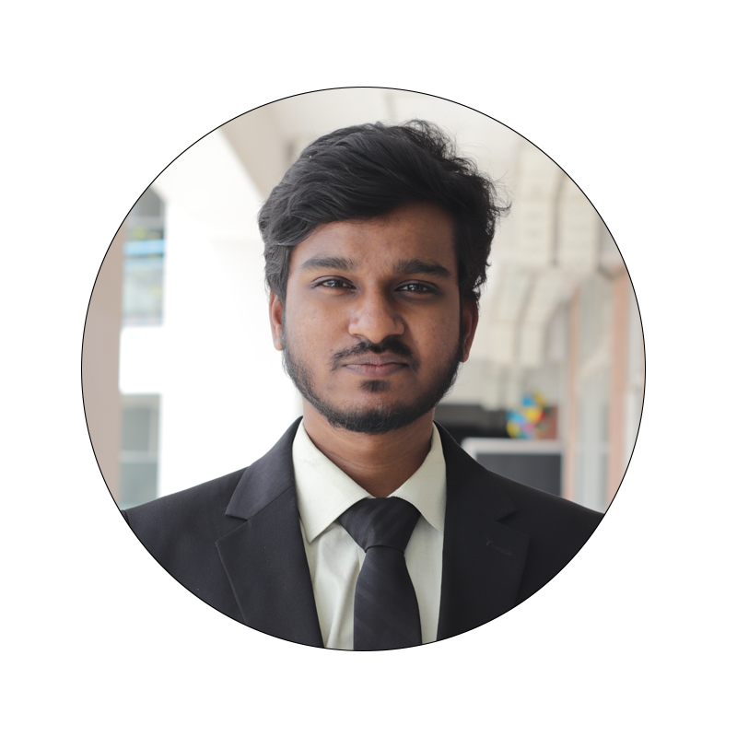
Md. Fahim Prodhan Id: 221-15-4809 Dept. of Computer Science & Engineering

Slide 2
Gadget Shop [E-Commerce Website]

Slide 3
CONTENTS
01
About the Project
02
Major Requirements
03
Project Goals
Customer can buy Gadgets from this website and authority can manage the Shop in online
Spring boot for backend and Angular for frontend development
Make the student hassle-free in buying Products and a proper management system

Slide 4




Technologies
Backend
Frontend
Database
Spring Security: JWT-based authentication and authorization
RESTful APIs: for handling bus ticket reservations, cancellations
Role-based access control (RBAC): for managing user roles and permissions
Html
CSS
TypeScript

Slide 5
ABOUT THE PROJECT
Features
Authentication & Authorization
Secure Payment System
Admin Management
Reporting and Analytics

Slide 6
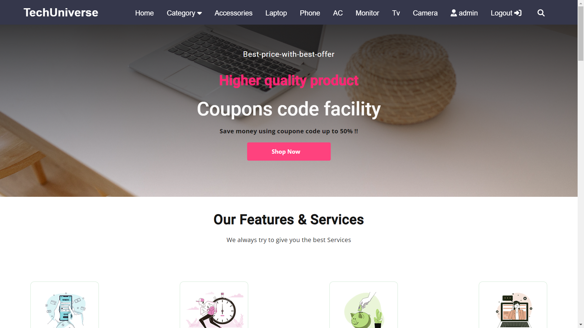

Slide 7
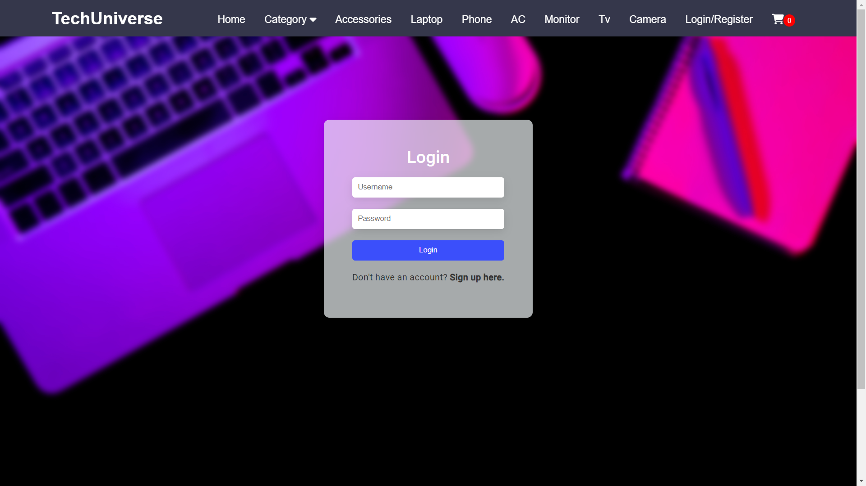

Slide 8
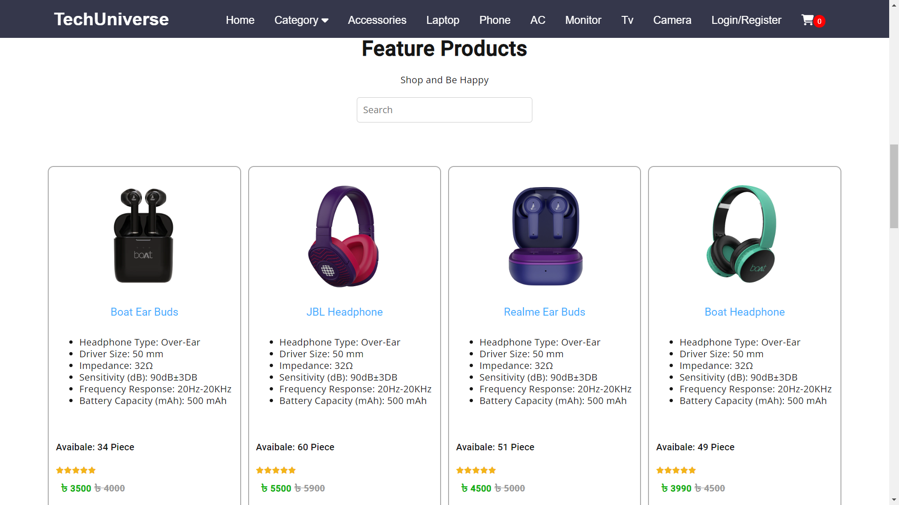

Slide 9
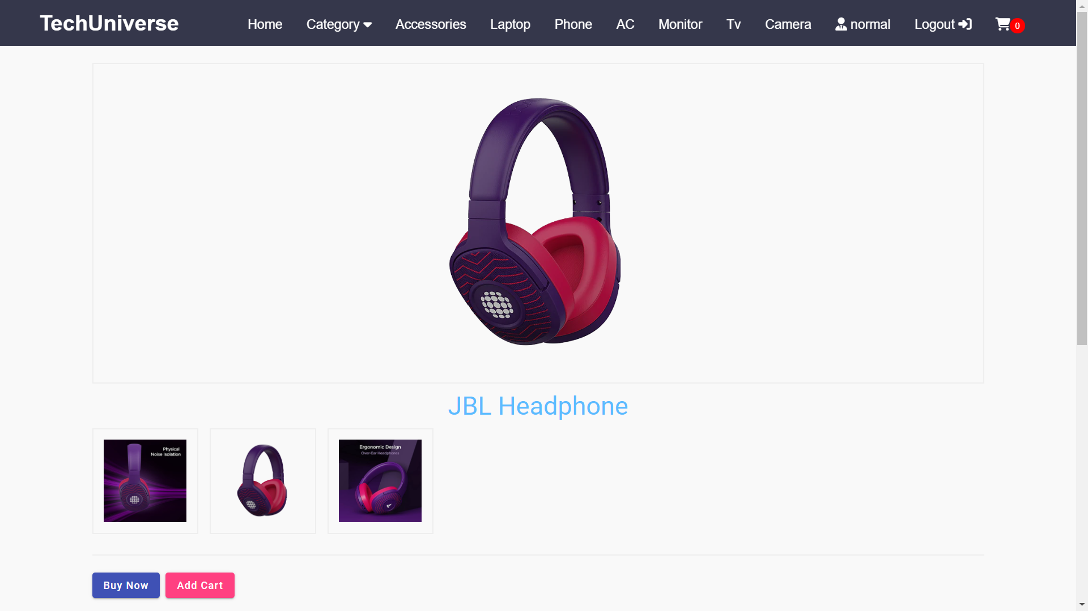

Slide 10
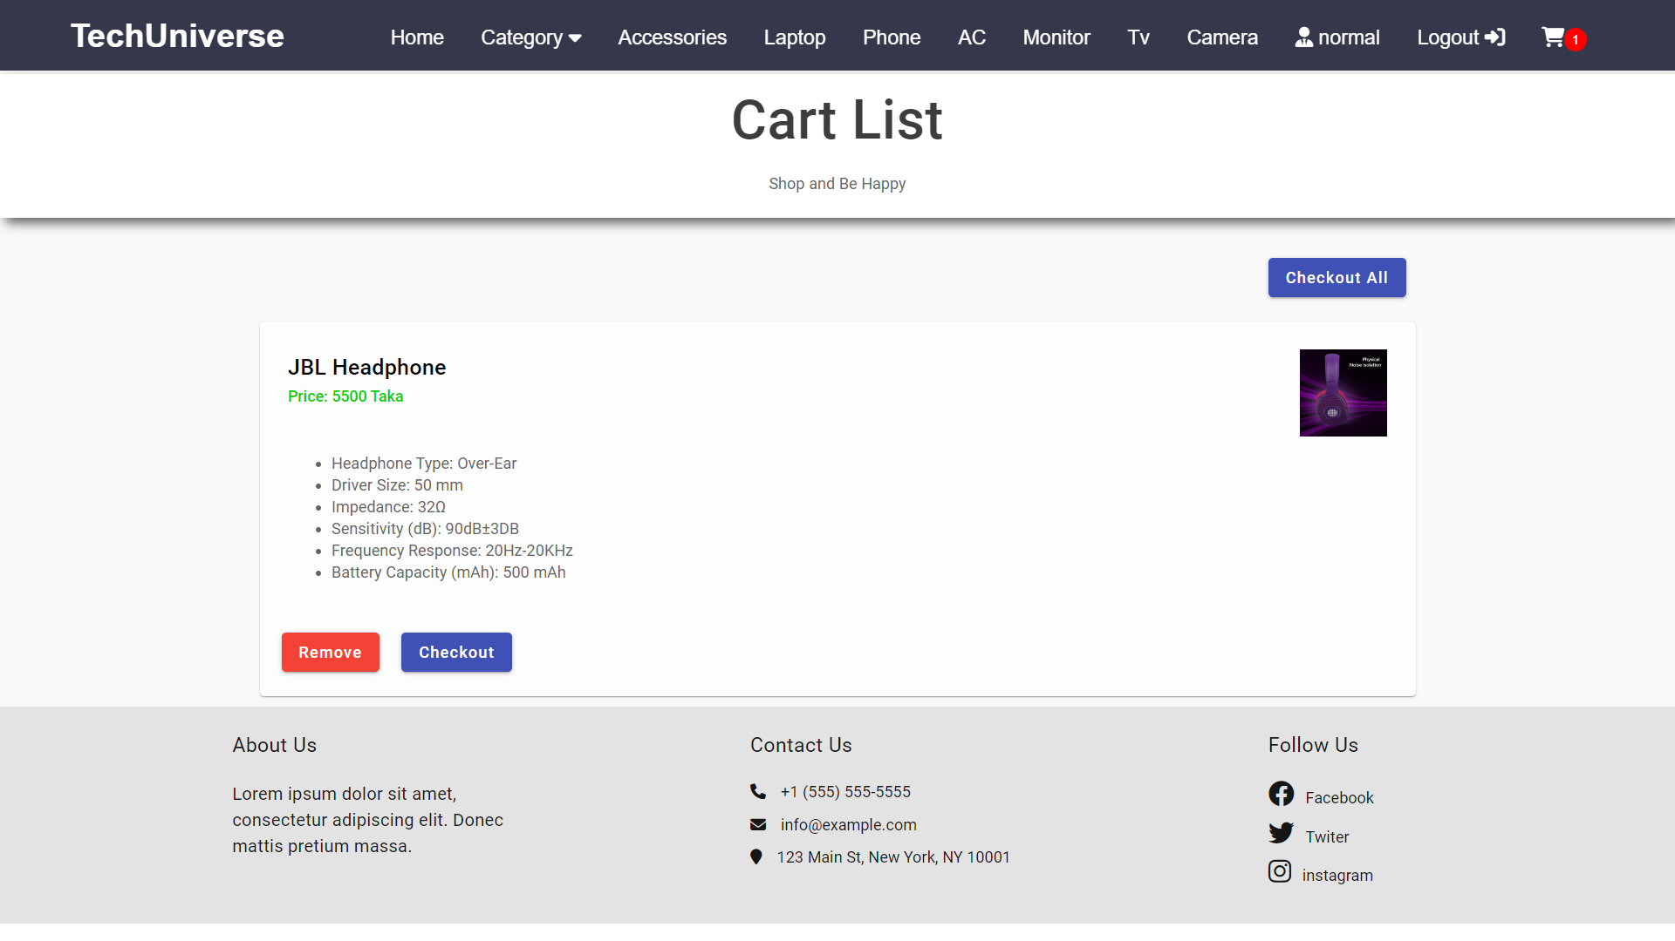

Slide 11
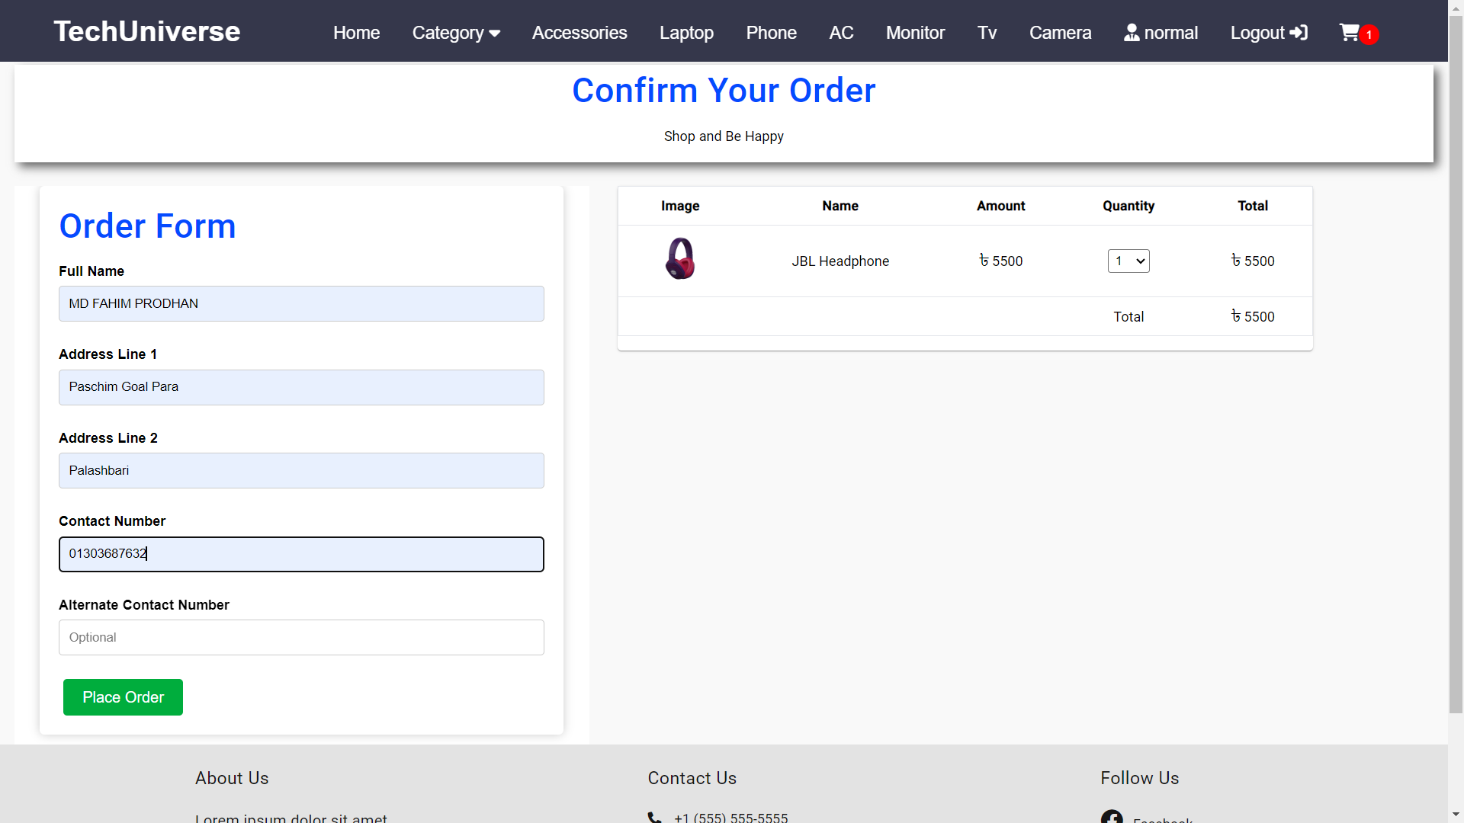

Slide 12
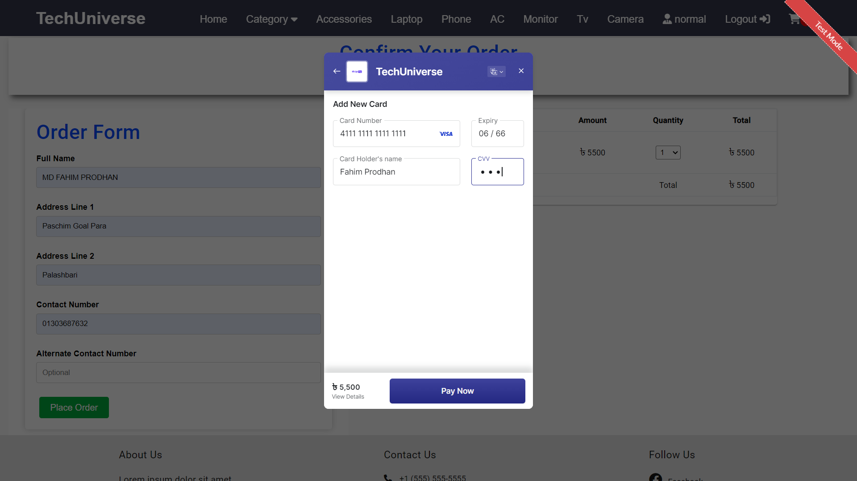

Slide 13
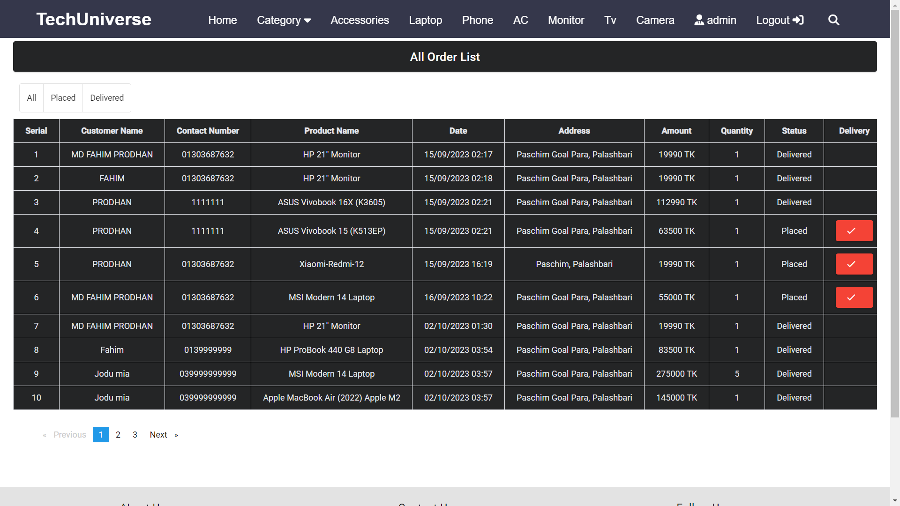

Slide 14
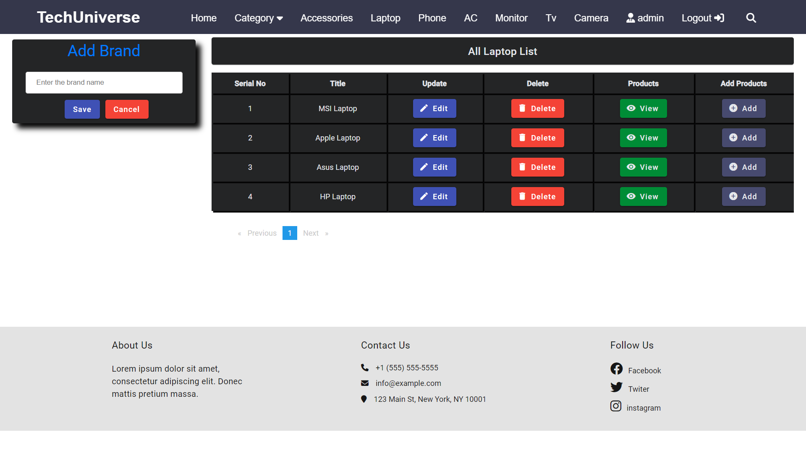

Slide 15
WHAT I AM WORKING ON
Security
Login Api
Integrate Machine learing

Slide 16


